Slide 2
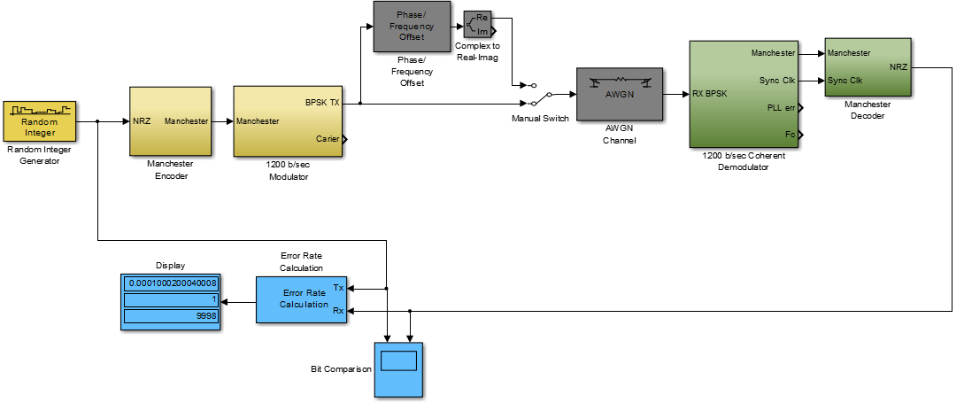
Simulink Model of BPSK Modem

Slide 3
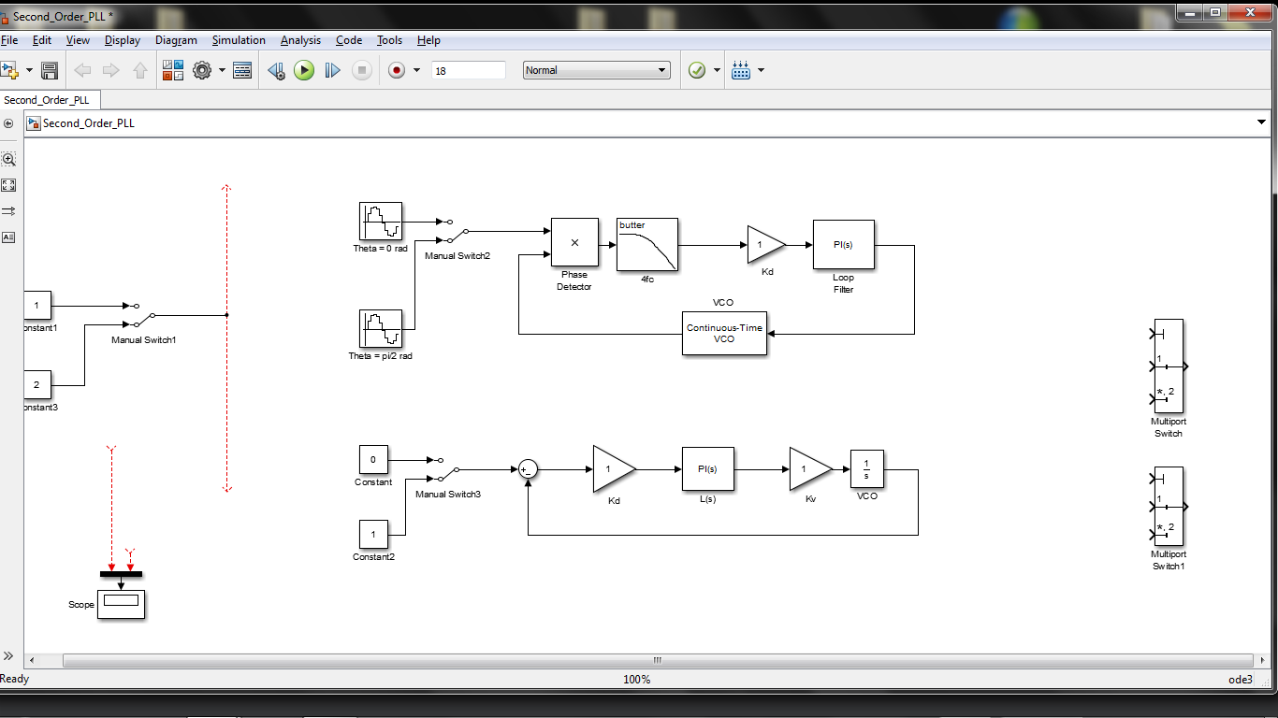
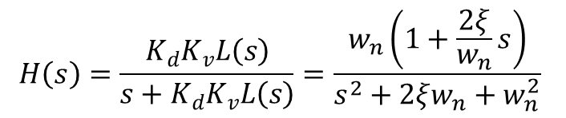
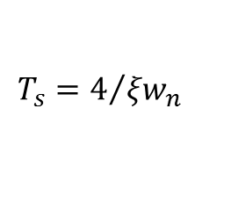
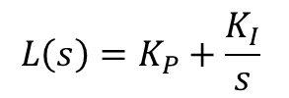
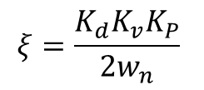

Phase Lock Loop Test and Verification
Actual PLL Implemented in squaring loop demodulator
Linearized PLL model used for verifying equations match actual PLL response
$$H\left(s\right)=\frac{K_{d}K_{v}L\left(s\right)}{s+K_{d}K_{v}L\left(s\right)}=\frac{w_{n}\left(1+\frac{2ξ}{w_{n}}s\right)}{s^{2}+2ξw_{n}+w_{n}^{2}}$$
$$L\left(s\right)=K_{P}+\frac{K_{I}}{s}$$
$$w_{n}=\sqrt{K_{d}K_{v}K_{I}}$$
$$T_{s}=4/{{ξw}_{n}}$$
$$ξ=\frac{K_{d}K_{v}K_{P}}{2w_{n}}$$

Slide 4
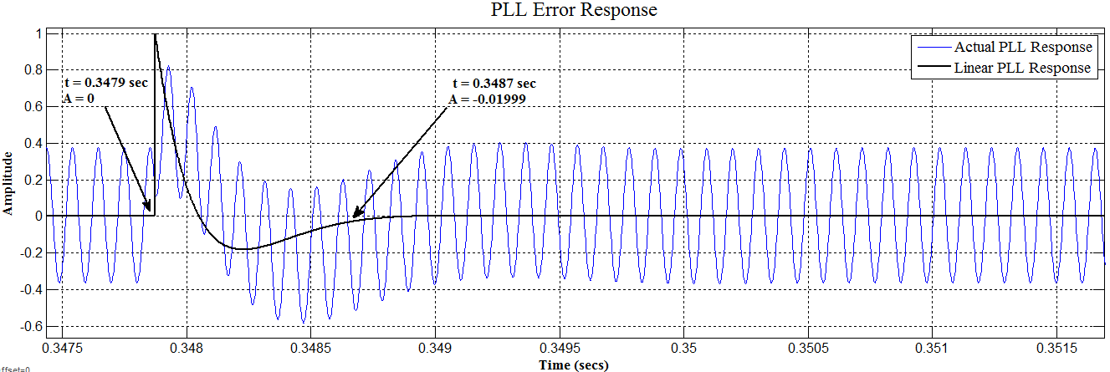
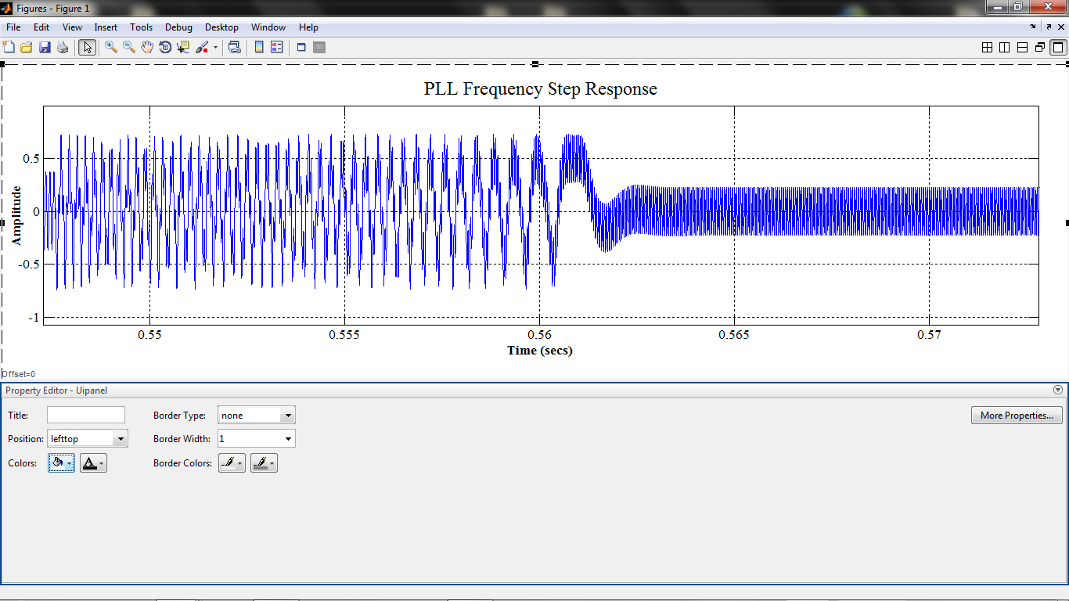
Phase Lock Loop Test Results
Comparison of Actual PLL response and Linearized PLL response provides confidence our modem will perform according to equations on previous slide
Designed to have settling time of 1/1200 sec to minimize bit error during random phase shifts
Succesffuly tracks frequency steps of +/- 4800 Hz with settling time of 1.75msec

Slide 5
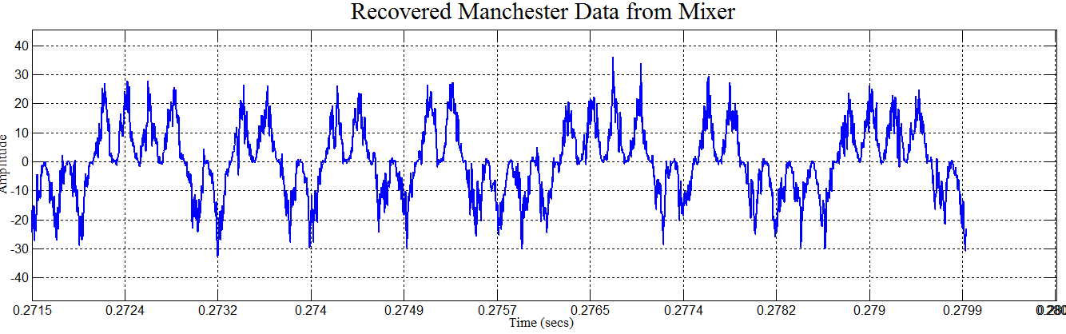
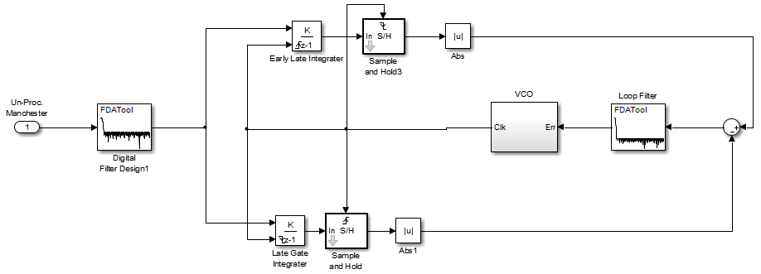
Early-Late Gate Timing Recovery
Input data stream to early-late gate circuit after correlating the recovered carrier and received BPSK signal
Top branch integrates from first half of bit period and bottom branch integrates second half of bit period
Accumulated voltages are sampled and compared to generate an error that drives the VCO to the correct phase

Slide 6
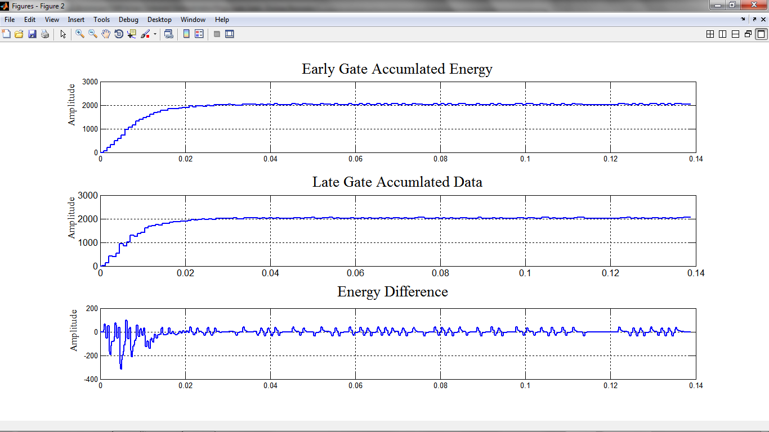
Early-Late Gate Simulation Results

Slide 7
Bit Error Rate Performance in AWGN
SNR (dB) | BER
26 | 0.0001
24 | 0.0002
22 | 0.0014
20 | 0.004601
18 | 0.0126
16 | 0.02951
14 | 0.05071
12 | 0.08321
10 | 0.49139

Slide 8
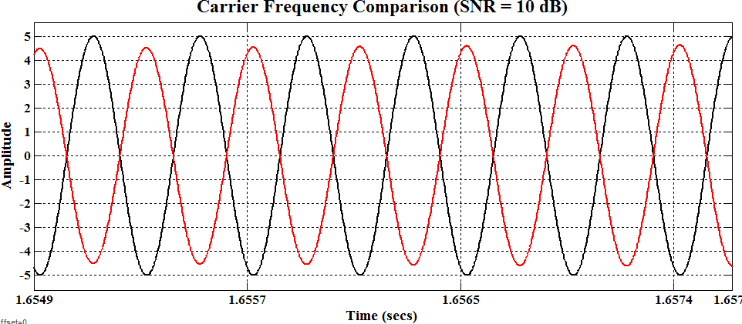
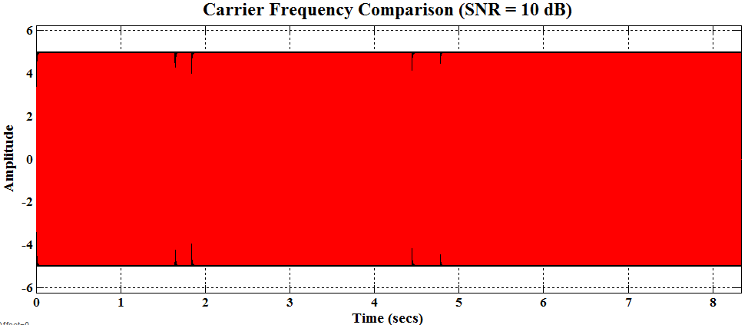
Polarity Reversal at 10 dB
AWGN at 10 dB causes 180 phase shifts resulting in the PLL tracking in the wrong direction
IMPLICATION: Necessitates need for differential encoding

Slide 9
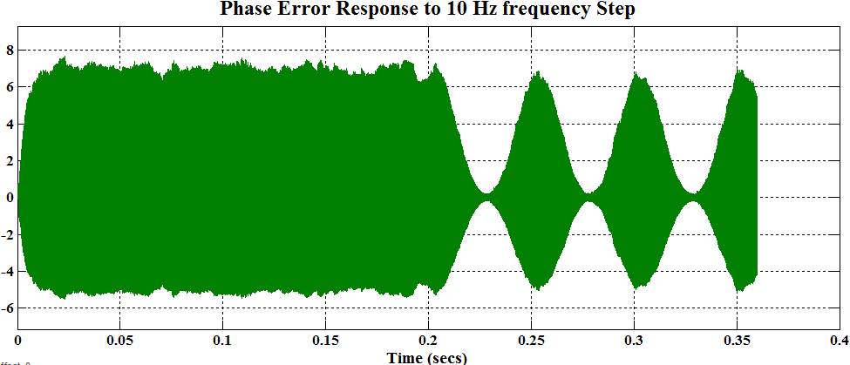
Phase Error Response to Frequency Step
PLL phase error becomes Amplitude Modulated after frequency step
IMPLICATION: Necessitates need for AGC

Slide 10
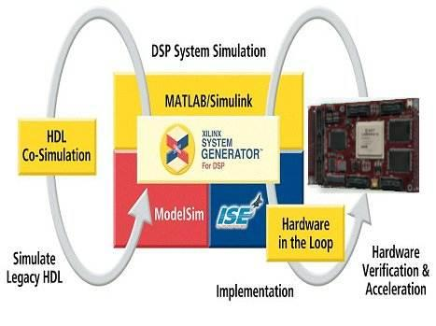
Future Work
___Winter Break___
Familiarization with System Generator and ISE Design Suite
Begin conversion of Simulink systems and sub-systems into hardware realizable that are to be implemented in FPGA
___Senior Design II ___
FPGA Implementation of FSK and BPSK modems
Test and verification of modem requirements.
Performance Comparison of BPSK modems

